Slide 1
Mrs. Hijran Huseynova
Chairperson of the State Committee for Family, Women and Children Affairs of the Republic of Azerbaijan
Baku, 5 December 2017

Slide 2
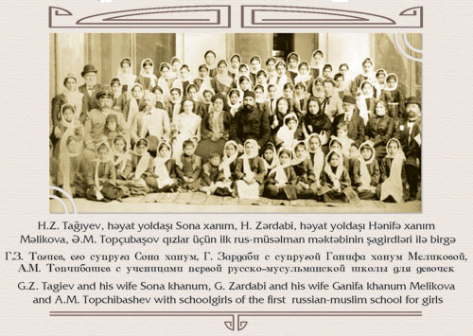
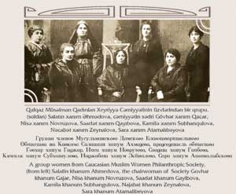
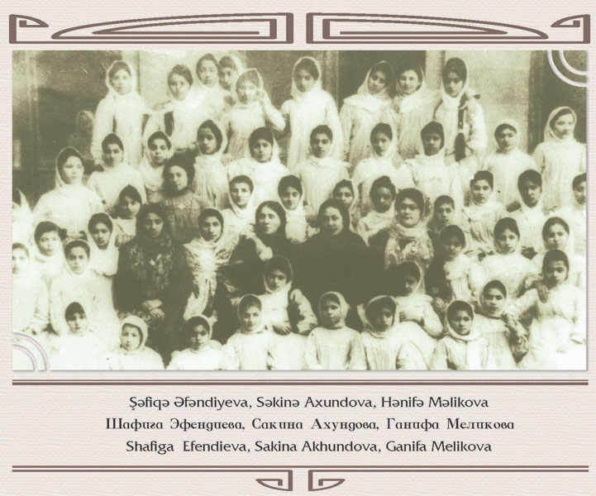
The First Secular School for girls was opened in Azerbaijan 116 years ago.
The suffrage was granted to Azerbaijani women 100 years ago thus making Azerbaijan the first Muslim country where women got equal political rights with men.

Slide 3
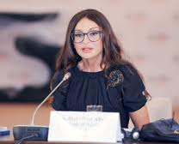
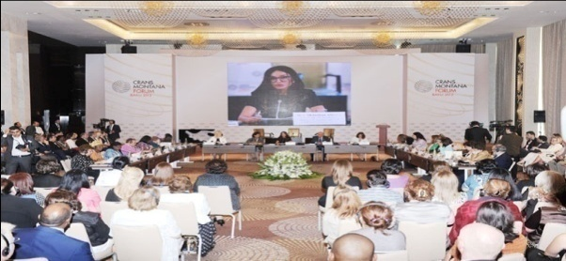
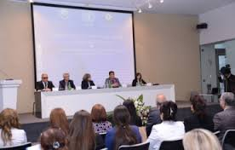
International events on ensuring gender equality and women's rights
7th Council of Europe Conference of Ministers responsible for Equality between women and men
“Women rights are human rights, human rights are women rights" in the framework of Crans Montana Forum
Forums of Women Entrepreneurs under the organisation of United Nations Economic Programme for Asia
The Fifth Ministerial conference on Women`s role in the Development of OIC Member states
Women in World Forum on Intercultural Dialogue

Slide 4
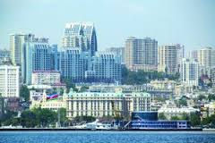
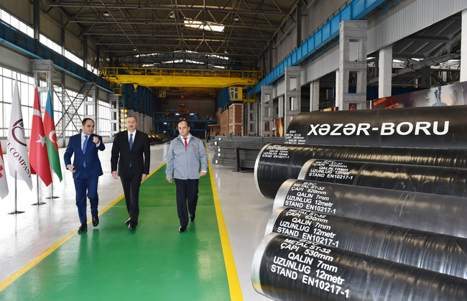
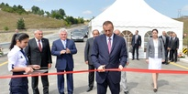
Over the past 20 years, our population exceeded 9 million 800 thousands. The unemployment rate in the country decreased to 5 percent. Poverty has decreased from 49% to 4,9%

Slide 5
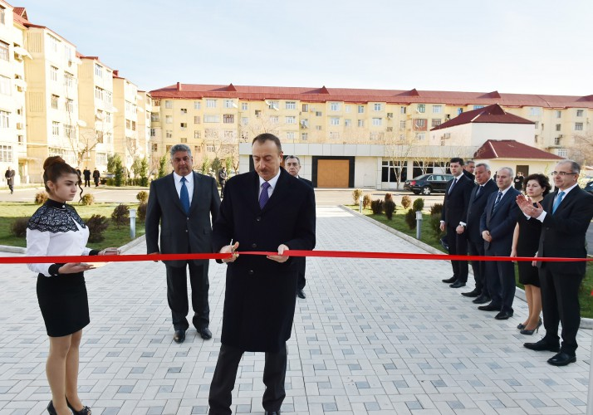
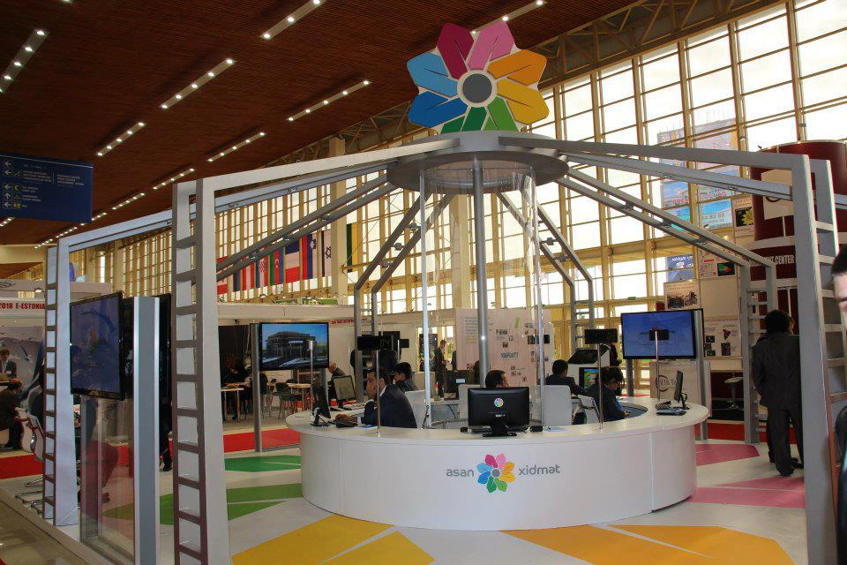
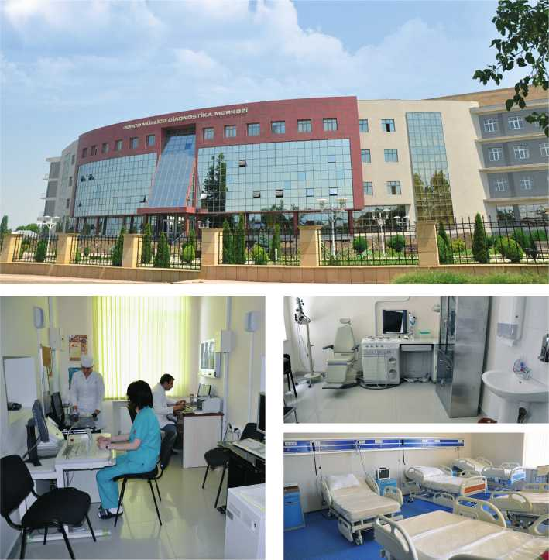
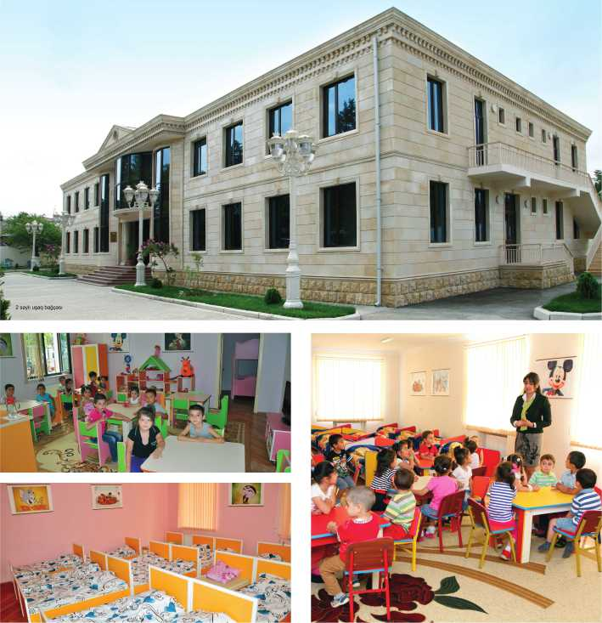

Slide 6
National Legislation:
The Constitution of the Republic of Azerbaijan (1995);
The Decree of the President of the Republic of Azerbaijan “On strengthening the role of women in Azerbaijan” (1998) ;
The Decree of the President of the Republic of Azerbaijan “On implementation of state women policy in Azerbaijan Republic” (2000);
The Law of Azerbaijan Republic “On guarantees of gender equality” (2006);
The Law of the Republic of Azerbaijan on Combating Domestic Violence (2010)

Slide 7
State Programs
State program “Population development and demography for 2015-2025
Social - economic development of the regions 2009-2015
State Program on poverty reduction and sustainable development 2007 – 2015
Azerbaijan-2020:the vision of future
State Program on Azerbaijani Youth 2011-2018
State Program for improving mother and child`s health 2014-2020
State program on Development of Justice in Azerbaijan February 2009-2013
National Action Plan for increasing the efficiency of protection of human rights and freedoms 2011

Slide 8
Family Code
Minimum age of marriage for girls has been risen from 17 to 18 by the Amendments to the Family Code
Marriage age can be decreased to 17 for girls and boys under specific conditions with the agreement of families and other sides by Executive Power

Slide 9
Criminal Code
176-1. Forcing women into marriage
176-1.1. Forcing women to marry against their will is punished by 2,000 to 3,000 manats or a jail sentence of up to two years
176-1.2. If these offenses affect underage persons, the fines amount is 3,000 to 4,000 manats and the violators will face up to four years in prison.

Slide 10
Azerbaijan 2020: A Look in to the Future and Sustainable Development Goals for 2016-2030
Ensures effective state governance, rule of law and complete exercise of all human rights and freedoms, and reaches a development stage characterized with an active status of civil society in the country's public life:
The improvement of legislation and strengthening of institutional potential
The improvement of the economic structure and the development of the non-oil sector
The provision of gender equality and the development of family:
The formation of a modern education system
The improvement of the social security system
The development of youth potential

Slide 11
Presidential decree on Strategic Road Maps on the national economy and main sectors of the economy
The key objective of the approved document is
to decrease the dependence on resources
to overcome the potential risks, through the sustainable and competitive development of non-oil sector in Azerbaijan

Slide 12
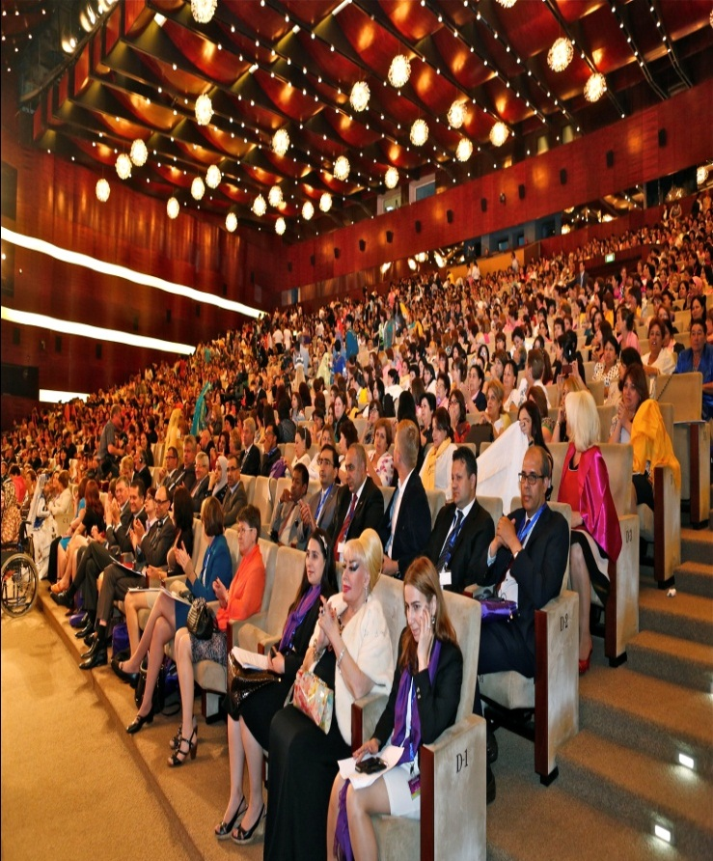
Congress of Azerbaijan Women as significant events emphasize the role of women in Azerbaijan focuses on increasing role of women in modern societies and other acute problems in the relevant spheres :
The 1st Congress of Azerbaijani Women in 1998
The 2nd Congress of Azerbaijani Women in 2003
The 3rd Congress of Azerbaijani Women
in 2008
The 4rd Congress of Azerbaijani Women in 2013

Slide 13
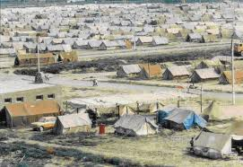
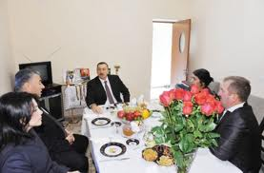
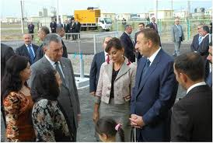
Refugees and internally displaced women and children as a result of Armenian invasion
The number of refugees and internally displaced women - 453 731
The number of refugees and internally displaced children -309 080

Slide 14
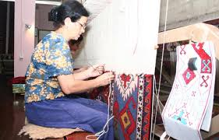
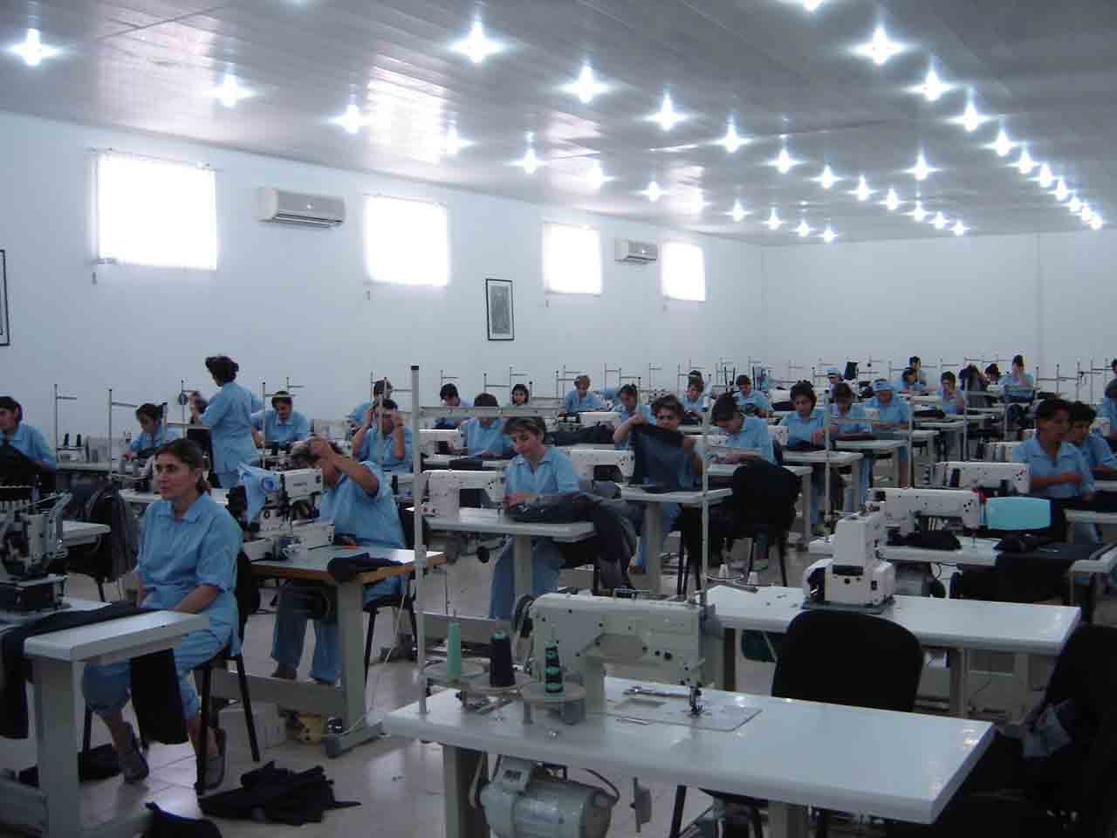
The number of currently employed women refugees is 53. 230 . The number of women refugees in Parliament is 2; 495 of the women refugees are the civil servants, 16.351 are in the in the sphere of education, 4543 are employed in the health structures, 23.793 in agriculture.

Slide 15
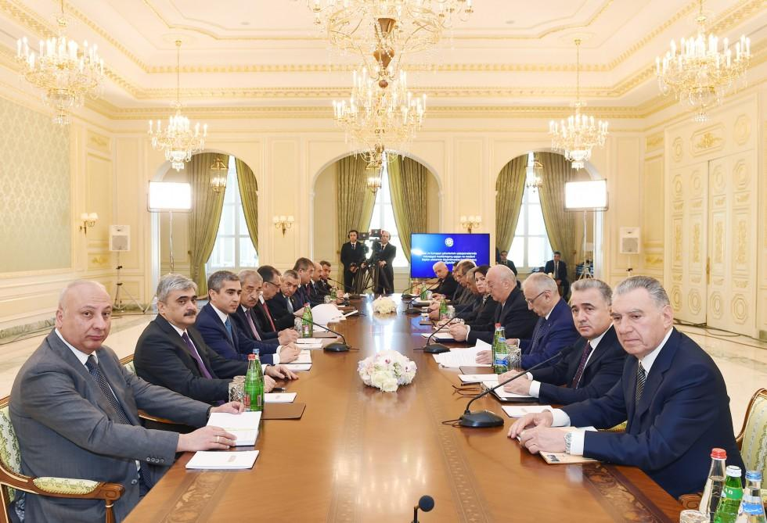
Meeting dedicated to the resettlement of refugees and IDPs temporary settled in dormitories of Baku and Sumgait under the chairmanship of Mrs. Mehriban Aliyeva, First Vice-President of the Republic of Azerbaijan.

Slide 16
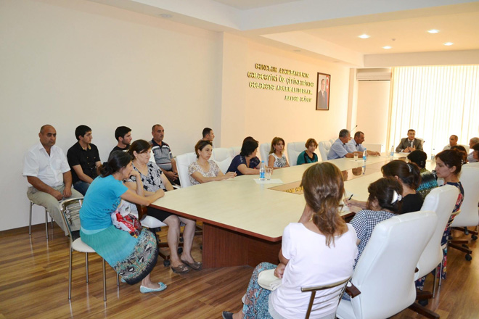
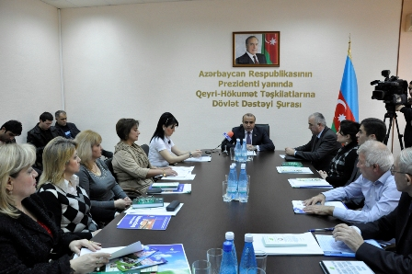
Youth Fund under the President of Azerbaijan was created in 2011
Youth Fund financed :
57 projects on the rights of women in the amount of 500 000 USD in 2012-2014
439 individual project of the young women
46 out of 300 youth NGOs are chaired young women
Since 2007 new project on crisis Hot line for youth has been supported by the Ministry of Youth. Every month more than 300 calls connecting with problems with families, parents, education and etc. are registered.

Slide 17
Economically active population
 | 2005 | 2010 | 2015 | 2016
Number of economically active population - total, thsd. persons | 4380,1 | 4587,4 | 4915,3 | 5012,7
men | 2268,8 | 2329,7 | 2510,8 | 2573,2
women | 2111,3 | 2257,7 | 2404,5 | 2439,5
Employed in summary quantity of economically active population - total, thsd. persons | 4062,3 | 4329,1 | 4671,6 | 4759,9
men | 2104,7 | 2227,4 | 2408,2 | 2465,7
women | 1957,6 | 2101,7 | 2263,4 | 2294,2
Unemployed persons - total, thsd. persons | 317,8 | 258,3 | 243,7 | 252,8
men | 164,1 | 102,3 | 102,6 | 107,5
women | 153,7 | 156,0 | 141,1 | 145,3
of which:
persons received official unemployment status in employment service offices, total, person | 56343 | 38966 | 28877 | 32972
men | 27265 | 21979 | 17728 | 20418
women | 29078 | 16987 | 11149 | 12554
of which:
receiving benefits as unemployed, total, person | 2087 | 87 | 1543 | 1857
men | 1316 | 70 | 1087 | 1238
women | 771 | 17 | 456 | 619

Slide 19
Women entrepreneurs

Slide 20
Women entrepreneurs

Slide 21
National Entrepreneurship Support Fund
Soft credit lines up to 7,7 million AZN were given to 317 IDPs in 2014
545 new job places has been opened
Soft credit lines up to 5,1 million AZN were given to 293 IDPs entrepreneurs in 2015
366 new job places has been opened

Slide 22
Soft credit lines up to 3 million 600 thousands AZN were given to 188 women entrepreneurs in 2012
Soft credit lines up to 9 million 300 thousands AZN were given to 430women entrepreneurs in 2013
Soft credit lines up to 9 million 300 thousands AZN were given to 703 women entrepreneurs in 2014
Soft credit lines up to 22,1 million AZN were given to 762 women entrepreneurs in 2015

Slide 23
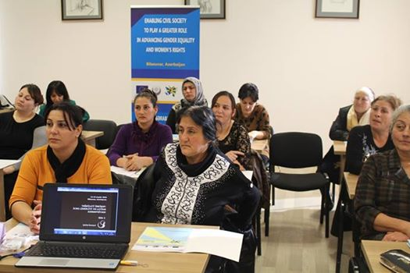
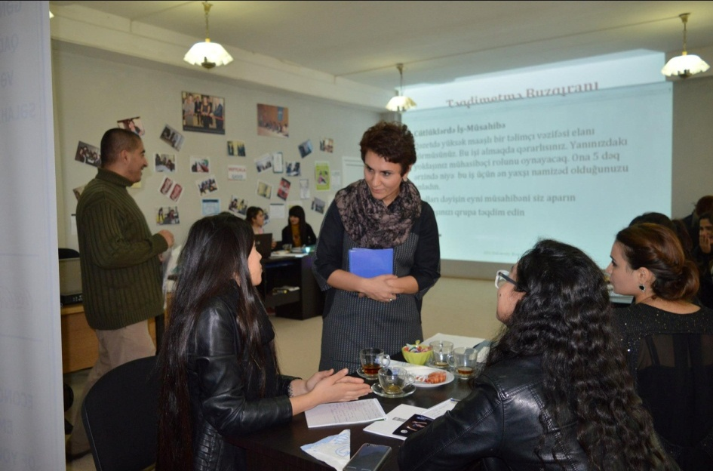
Enabling civil society to play greater role in advancing gender equality and women`s rights” implemented by European Union and United Nations Development Program (UNDP) in partnership with the State Committee for Family, Women and Children

Slide 24
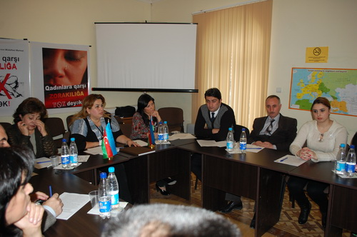
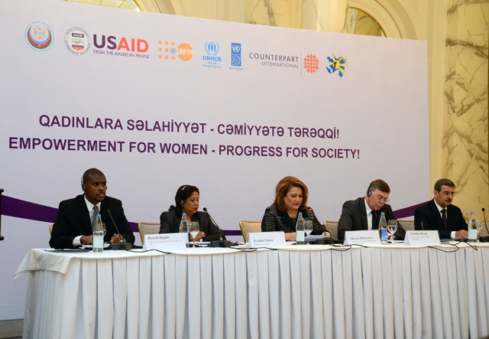
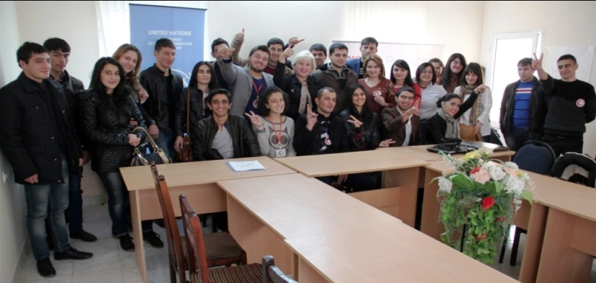
Adjusting IDPs women and refugees women to the changing needs of the society and economy by conducting vocational trainings, research and skills development

Slide 25
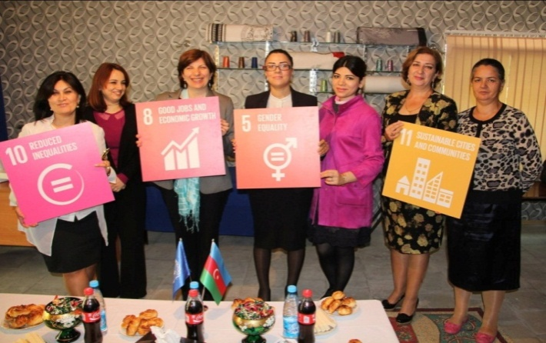
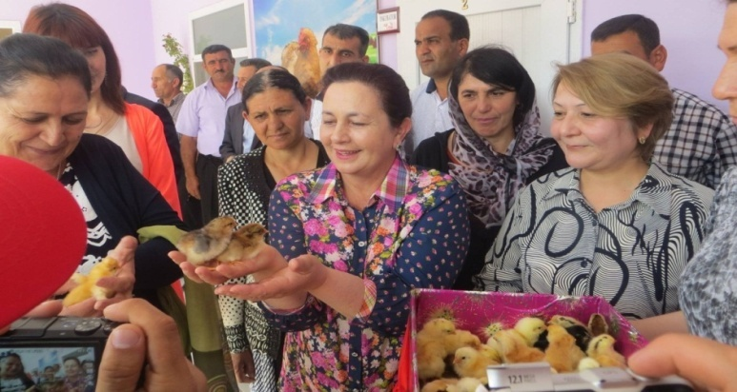
Women are enabled to more actively participate in economic activities and exercise their economic rights

Slide 26
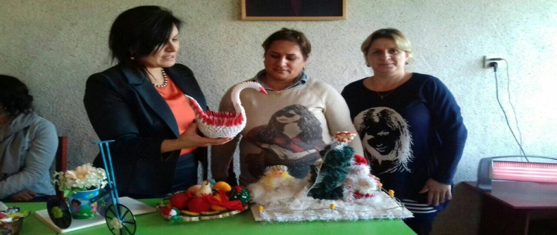
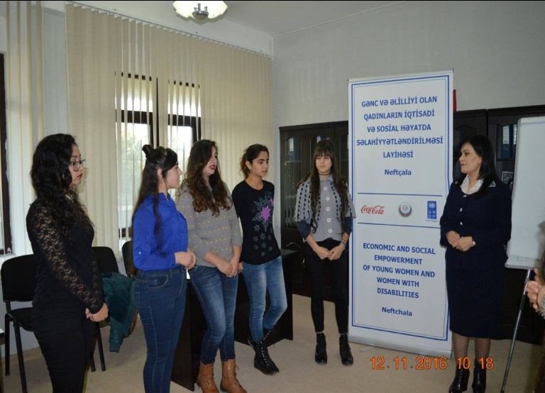
The project “Promoting Rural Women`s participation in the Social and Economic Life”
Support women willing to increase the level of their economic activity through capacity development and network building;
Strengthen the role of women in community based decision-making;
Sensitize private sector (banks, non-banking credit units and private companies) to gender needs and interests of women in rural areas;
Build capacity of the State Committee on Family, Women and Children’s Affairs to address the needs of women through advocacy, policy development and programmatic interventions.

Slide 27
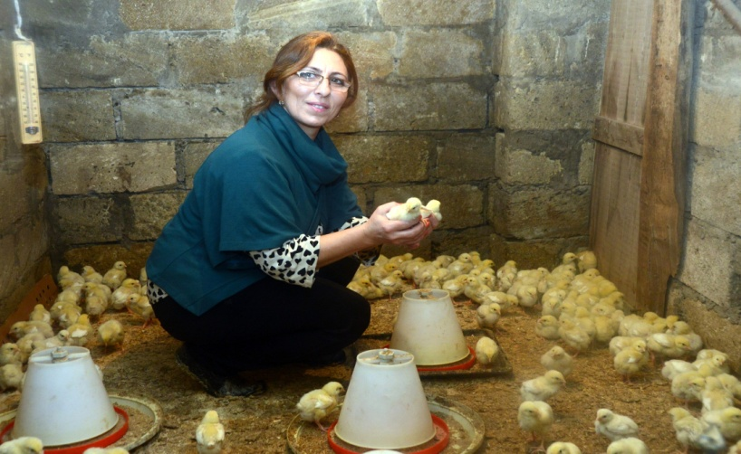
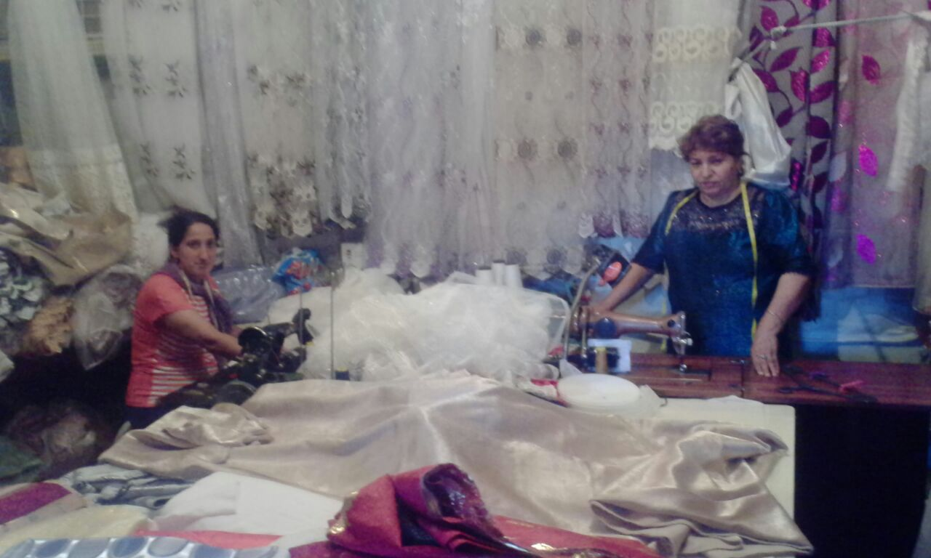

Slide 28
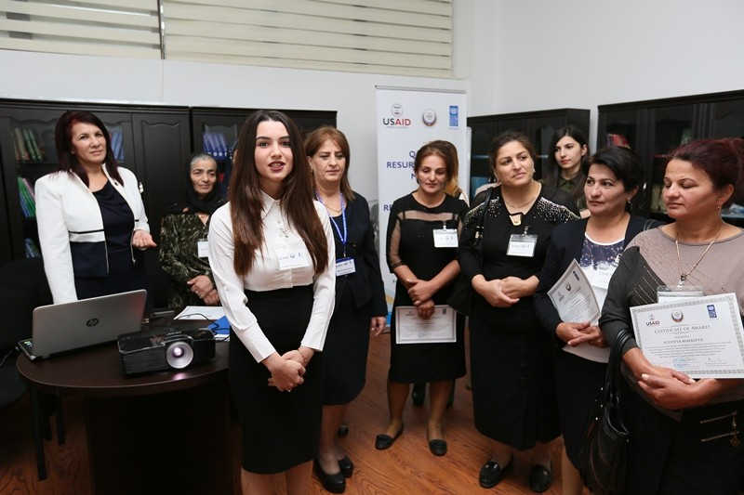
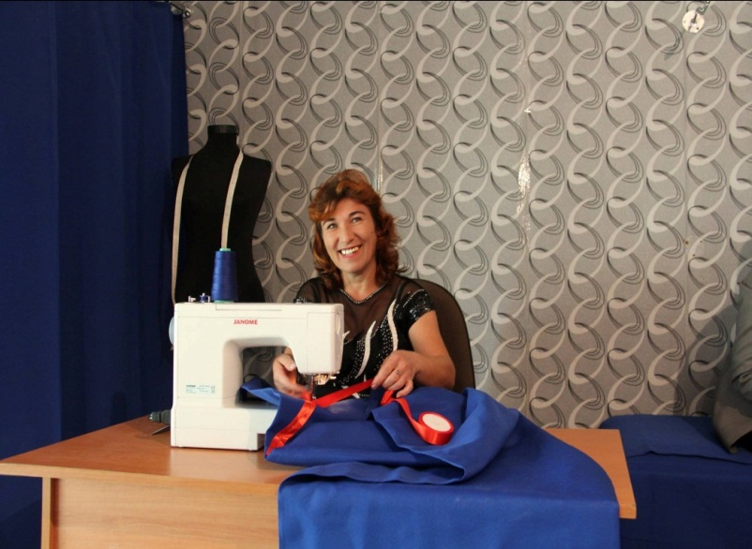
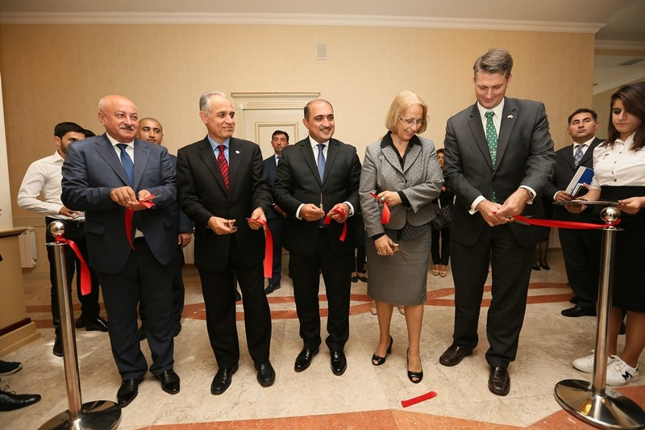
Women Resource Centres were established to support women’s civic engagement in Bilasuvar, Neftchala ,Sabirabad, Masalli, Salyan

Slide 29
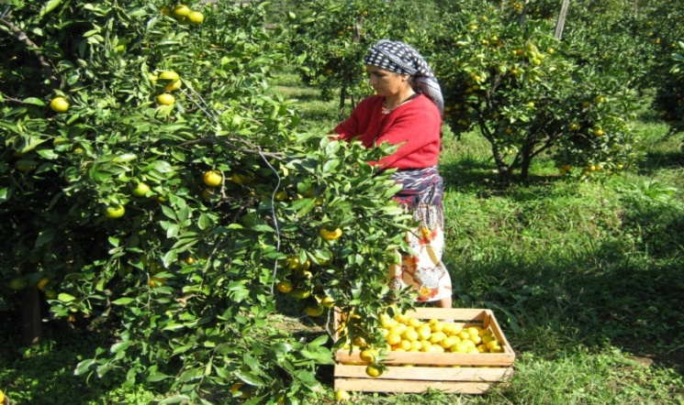
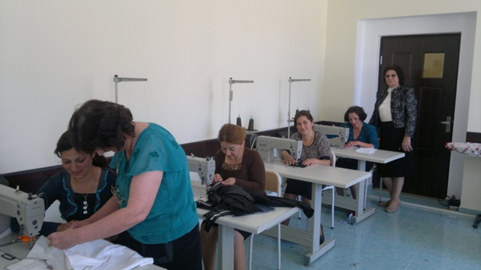
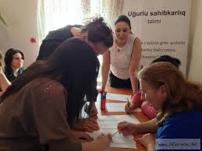
‘Start and Improve your Business’ training

Slide 30
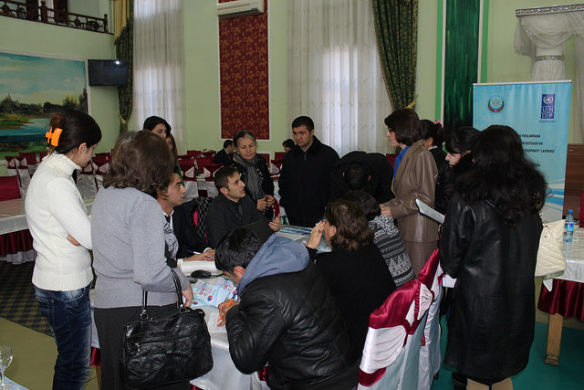
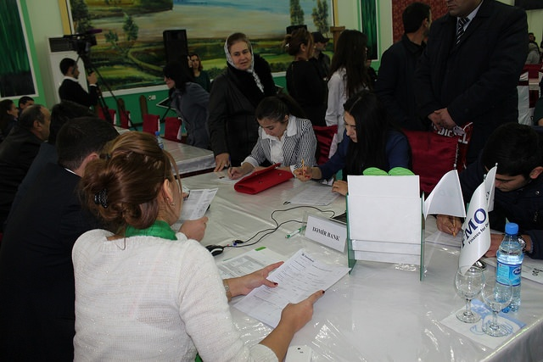
Organization of a Job Fair as a venue to bridge job-seeking
women with potential employers
The assessment of employment opportunities for women at the local labour market
Job search, CV writing, Interview Skills, Presentation skills and Effective Communication skills trainings
Business development trainings
Awareness raising and sensitization campaign to change gender stereotypes related to the choice of jobs and gender-based distribution of family duties

Slide 31
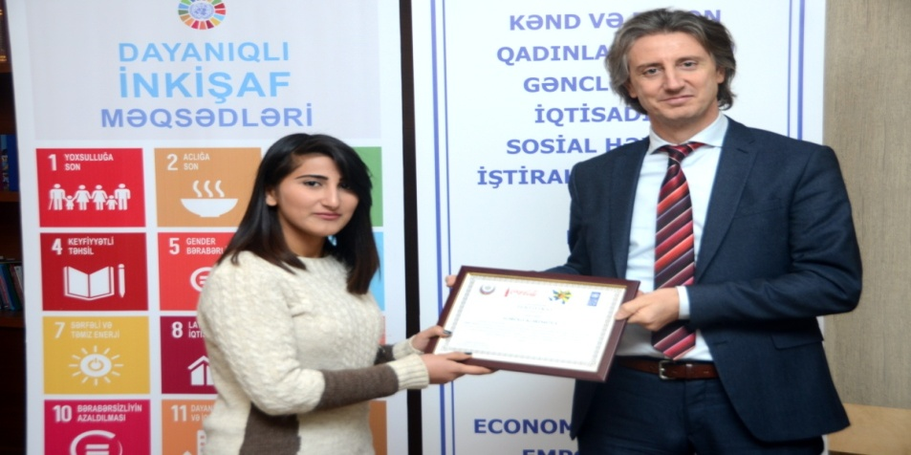
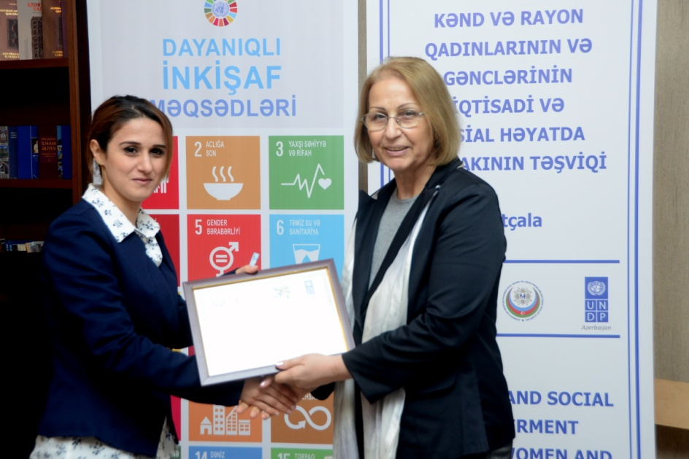
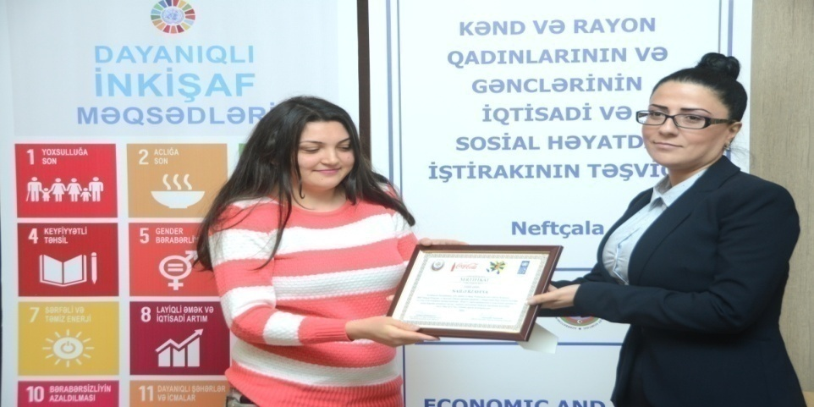
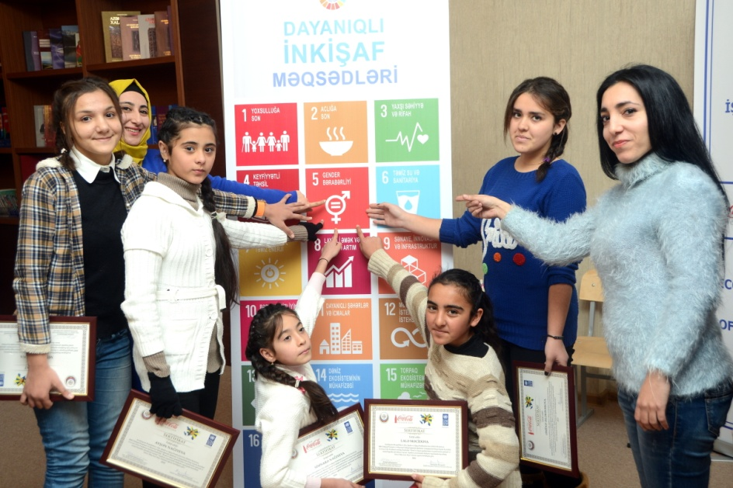

Slide 32
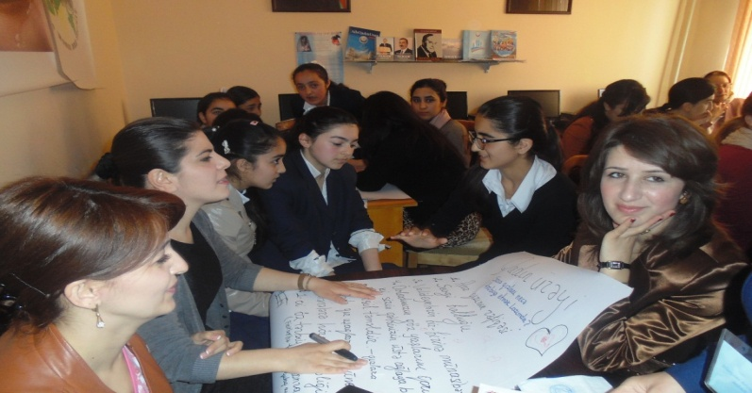
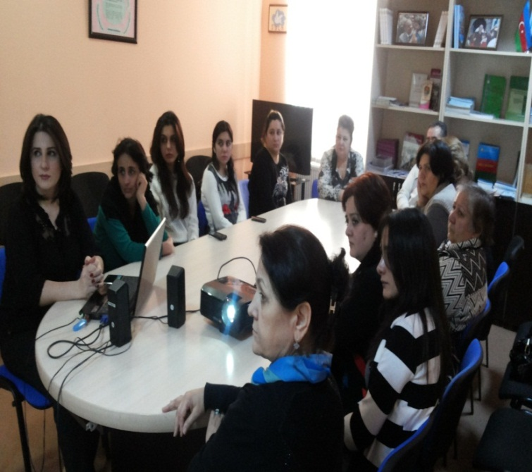
11 Child and Family Support Centers acting under the State Committee for Family Women and Children Affairs
Address the key gender issues;
Identify children and women in need of special care in community specially refugees and IDPs
Strengthen the capacity of
families and improve their wellbeing;
Provide consultations psychological aid, juridical and social advises to the women and children from vulnerable groups.
71 270 citizens were provided with legal and psychological aid by 11 regional centers during 2011-2016

Slide 33
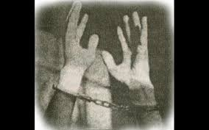
The State Commission of the Republic of Azerbaijan on Prisoners of War, Hostages and Missing People registered 3874 missing citizens of the
Republic of Azerbaijan.
-children: 66 (From them: 22 - girls, 44 - boys); - female persons: 265; - elderly people: 302 (From them: 152 - women)
Information received on persons were taken as hostage -871 persons
- children: 29 (From them: 7 - girls, 22 - boys); - female persons: 98; - elderly people: 111 (From them: 62 - women).

Slide 34
Thank you very much for your attention!

